Slide 1

CONTOSO
OUR VISION
Katie Jordan| July 2013
Exclusive Partner Agreement Analysis
Notes:
Executive Summary
Contoso has built a strong reputation in the electronics industry over the last three decades and consistently remains one of the three highest rated electronics companies by customers.
This PowerPoint shares Contoso’s growth trends, workforce culture, and a vision for the future.
Customer research conducted in early 2012 determined that consumer trends are very favorable to Contoso products, hitting a sweet spot that consumers are looking for: innovative, good-quality products for a good price from companies they know and trust.

Slide 2




Contoso Financials
SALES
CALCULATING PROFIT
HIGHEST REVENUE COUNTRIES
(from highest to lowest)
Japan
United States
France
United Kingdom
Germany
Canada
Australia
China
Russia
Austria
Italy
Spain
Norway
Mexico
Malaysia
Brazil
Chile
Argentina
Thailand
$$Profit=\left(Units ×Unit Price\right)−(Fixed Cost+(Variable Cost ×Unit Cost))$$
$$Gross Profit=\frac{Revenue−COGS}{Revenue} x 100\%$$
(Answer will be a percentage.)
Notes:
Contoso Financials
An analysis of Contoso’s financials for 2012. Overall Contoso sales in 2012 show that Contoso brand products are making up an increasing share of the electronics market.
A prime example is 3D TVs, which saw a marked increase to 60% of overall Contoso 3D TV sales in 2012.
If we look at 3D TV Sales over 2010 and 2012, we can clearly see the overall trend of customers increasingly choosing Contoso brand 3D TVs.
In the first half of 2010, Contoso brand 3D TVs made up just 27% of overall 3D TV sales.
However, by the end of the first half of 2012, that had increased to 42%.
By the end of 2012, it had increased to just over 60%.
The list on the right shows the highest revenue countries in Contoso products from highest grossing to lowest. This list demonstrates tremendous opportunity in emerging markets and small regions.

Slide 3
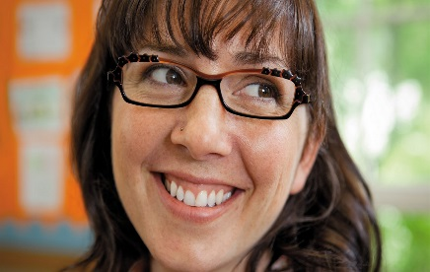

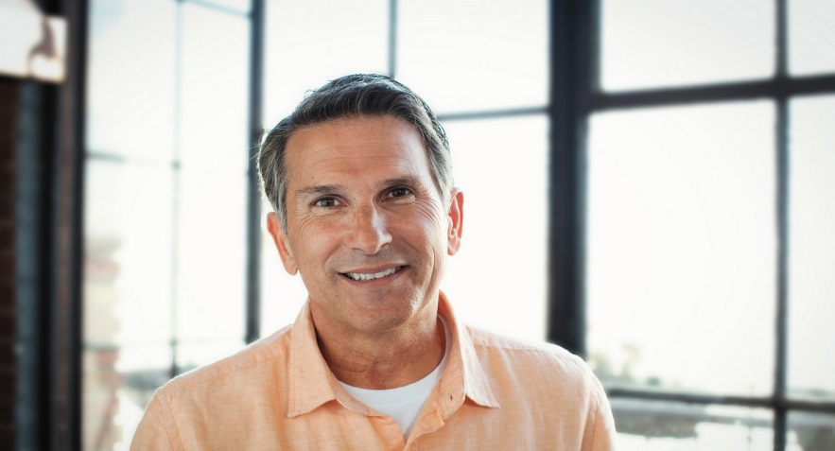
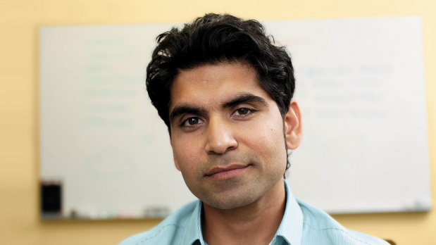
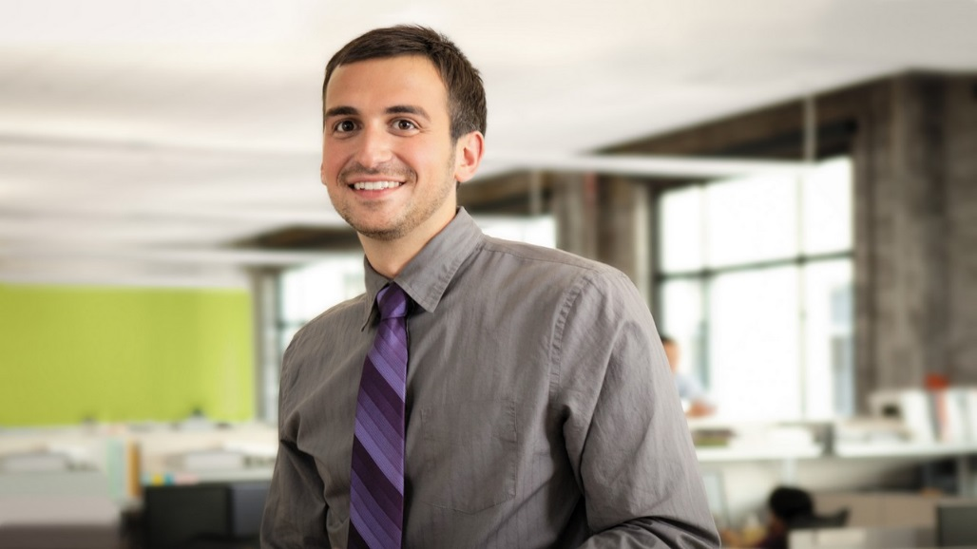
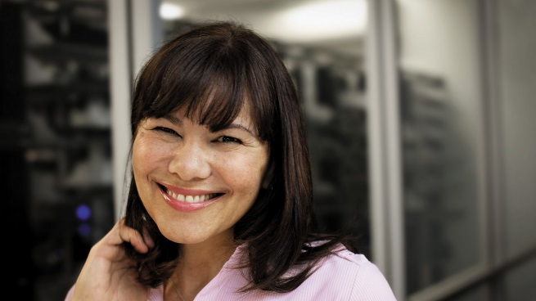
The Right People
Katie Jordan, U.S. Sales
Sara Davis, Asia
Garth Fort, Europe
Aziz Hassouneh, Customer Service
Alex Darrow, India
Dorena Paschke, France
Notes:
Our Workforce
Contoso has a leading reputation in recruiting and mentoring the right people. A strong leadership team and passionate employees fosters a positive work environment and a commitment to the company.
The current CEO of Contoso started as a salesman after college and quickly advanced to the leadership team.
This organizational chart lists the top leaders (Senior Vice Presidents and Vice Presidents) for each region—US, Europe, and Asia.
Most of the workforce (55%) is in the US with headquarters in New Jersey; and only 20% in Asia, and 25% in Europe.
Contoso continues their reputation in excellence, and hopes to implement more college recruiting efforts and leadership opportunities for recent MBA graduates.

